Slide 1
BAKERY MANAGEMENT SYSTEM

Slide 2
ABSTRACT
In our project, on “Bakery Management System”, we have tried to show how the data/information in Bakery is managed. This is just an overview of management System in Bakeries.
Our main intention is to process the order given by the customer efficiently by displaying the menu with availability of items to the customer and also we are trying to provide the token numbers to them and calculate the approximate time for their order to get ready. And finally we show them the bill and provide required payment options to the customer.

Slide 3
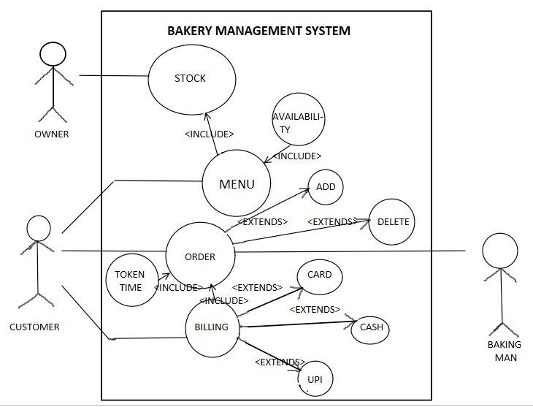
USE CASE DIAGRAM

Slide 4
TECHNOLOGY USED:
All compute software needs certain hardware components or other software components resources to be present. In order for computers to used efficiently these are the primary requestisites. There are two different categories of this section.
a. Software Requirements:
Software requirements mainly share out with defining the software resource requirements that need to be installed on a computer to provide optimal functioning of a particular application. These conditions are not included in the software installation package and need to be installed separately.
In order to use Bakery Management System the following are the prerequisties,
a. Operating System – Windows 7 and above
b. C Compiler – GNU Compiler
c. Editor – Any basic editor is preferable (Example: Notepad++)
b. Hardware Requirements:
Hardware requirements refer to the common set requirements defined by any operating system or software application and are usually the physical computer resources. In this section we basically deal with primary memory, secondary memory, processing power.
In order to use Bakery Management System one should have the following,
a. Processor - Intel Core i5 and above
b. Memory – 4GB Ram

Slide 5
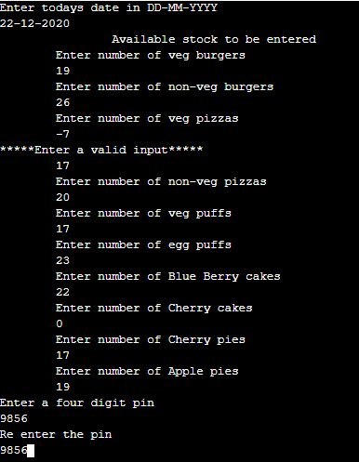
RESULTS:

Slide 6
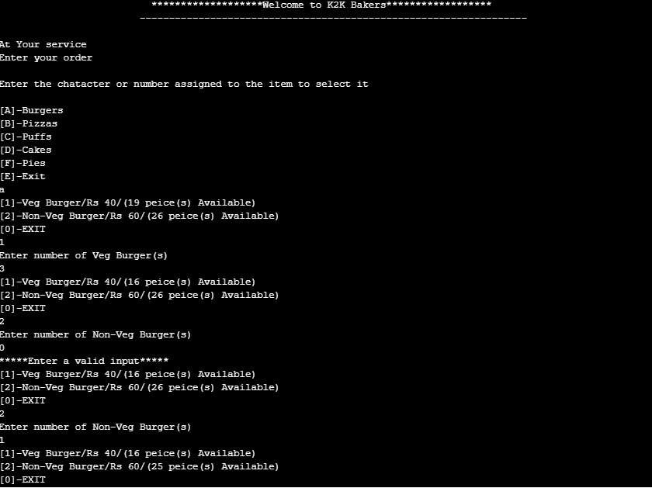

Slide 7
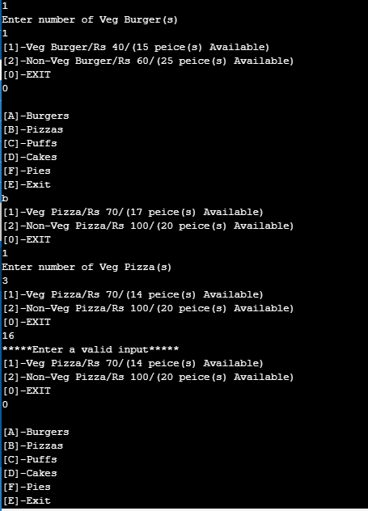

Slide 8
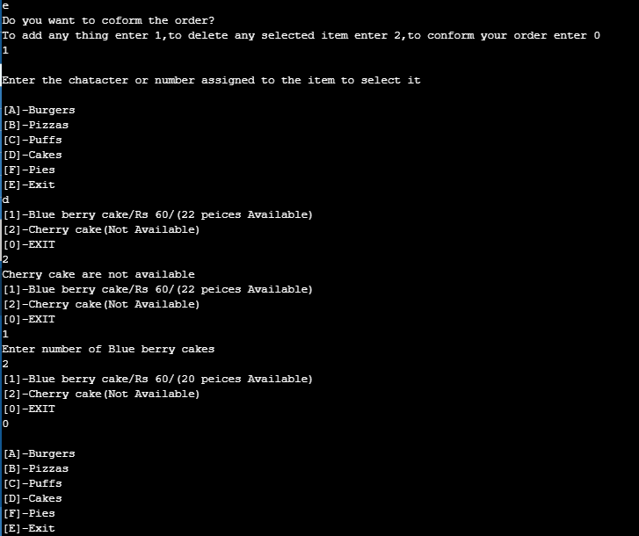

Slide 9
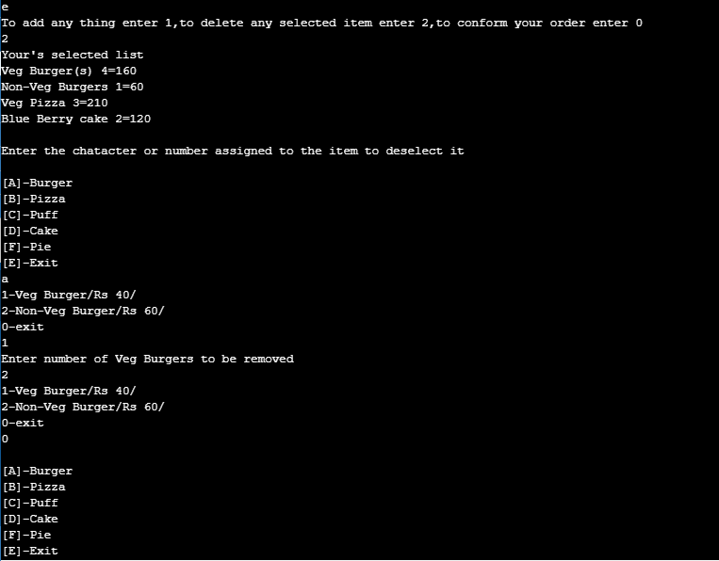

Slide 10
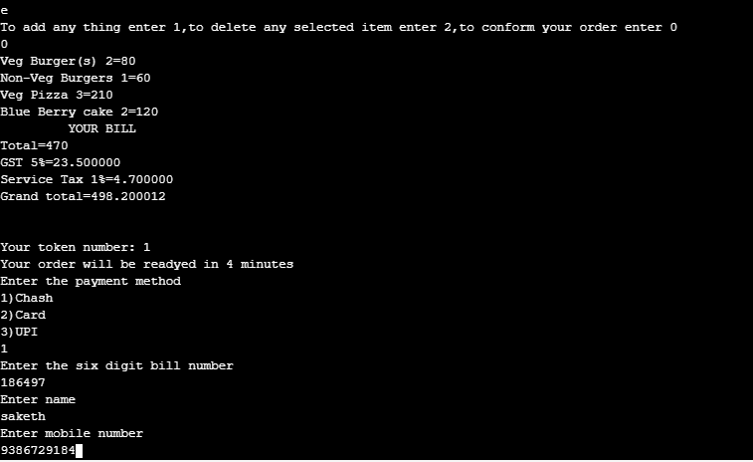

Slide 11
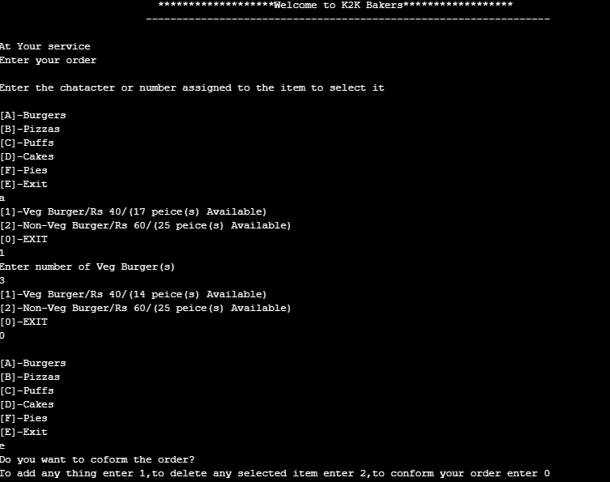

Slide 12
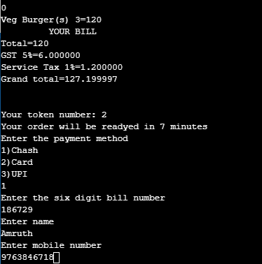

Slide 13
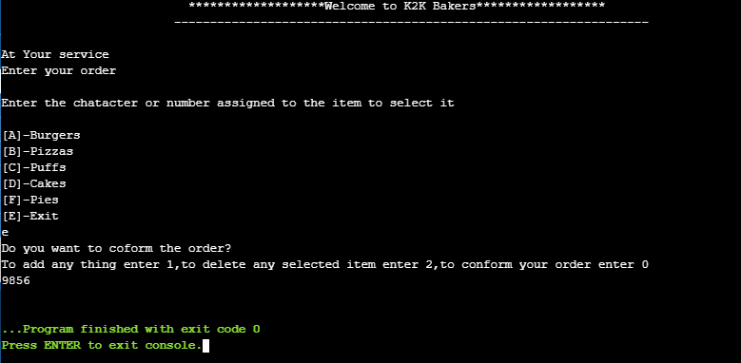

Slide 14
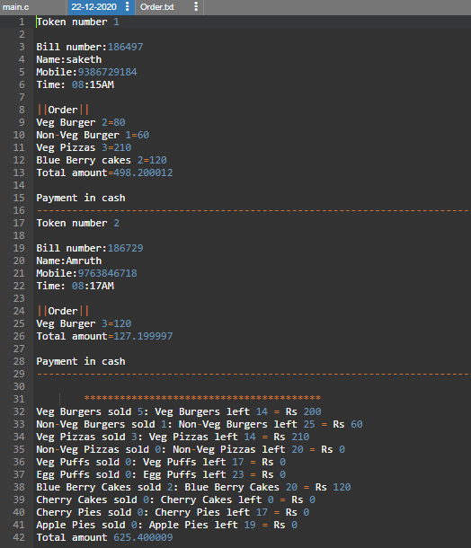

Slide 15
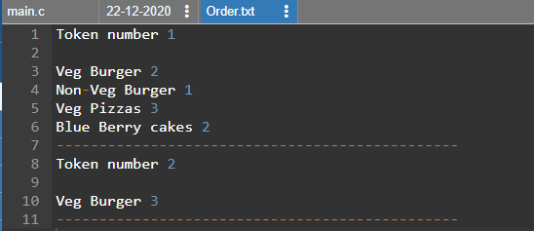

Slide 16
CONCLUSION AND FUTURE WORK
We conclude that our main intention is to process the order given by the customer efficiently by displaying the menu with availability of items to the customer and also we are trying to provide the token numbers to them and calculate the approximate time for their order to get ready. And finally we show them the bill and provide required payment options to the customer
Future work is to we develop the application in PHP Or HTML to make the real payment, make this console application as a web application

